Slide 1
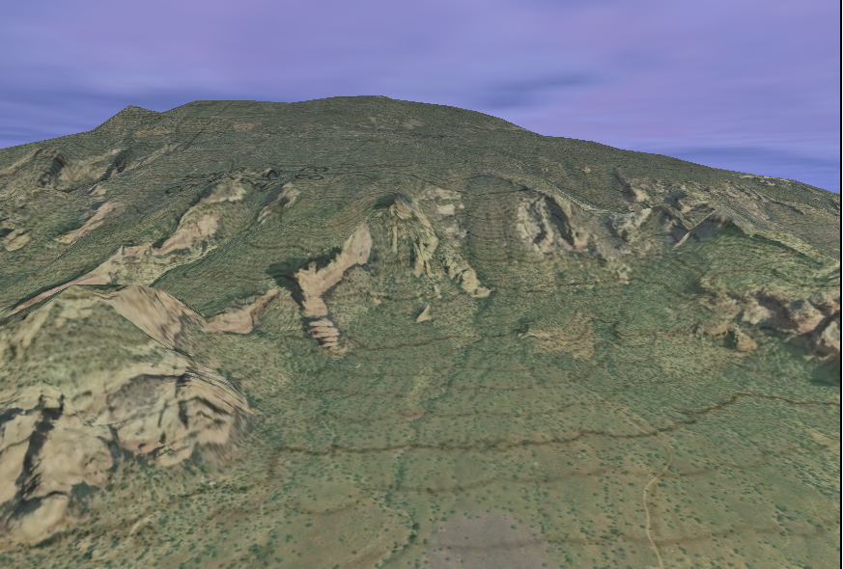
Questions?

Slide 2
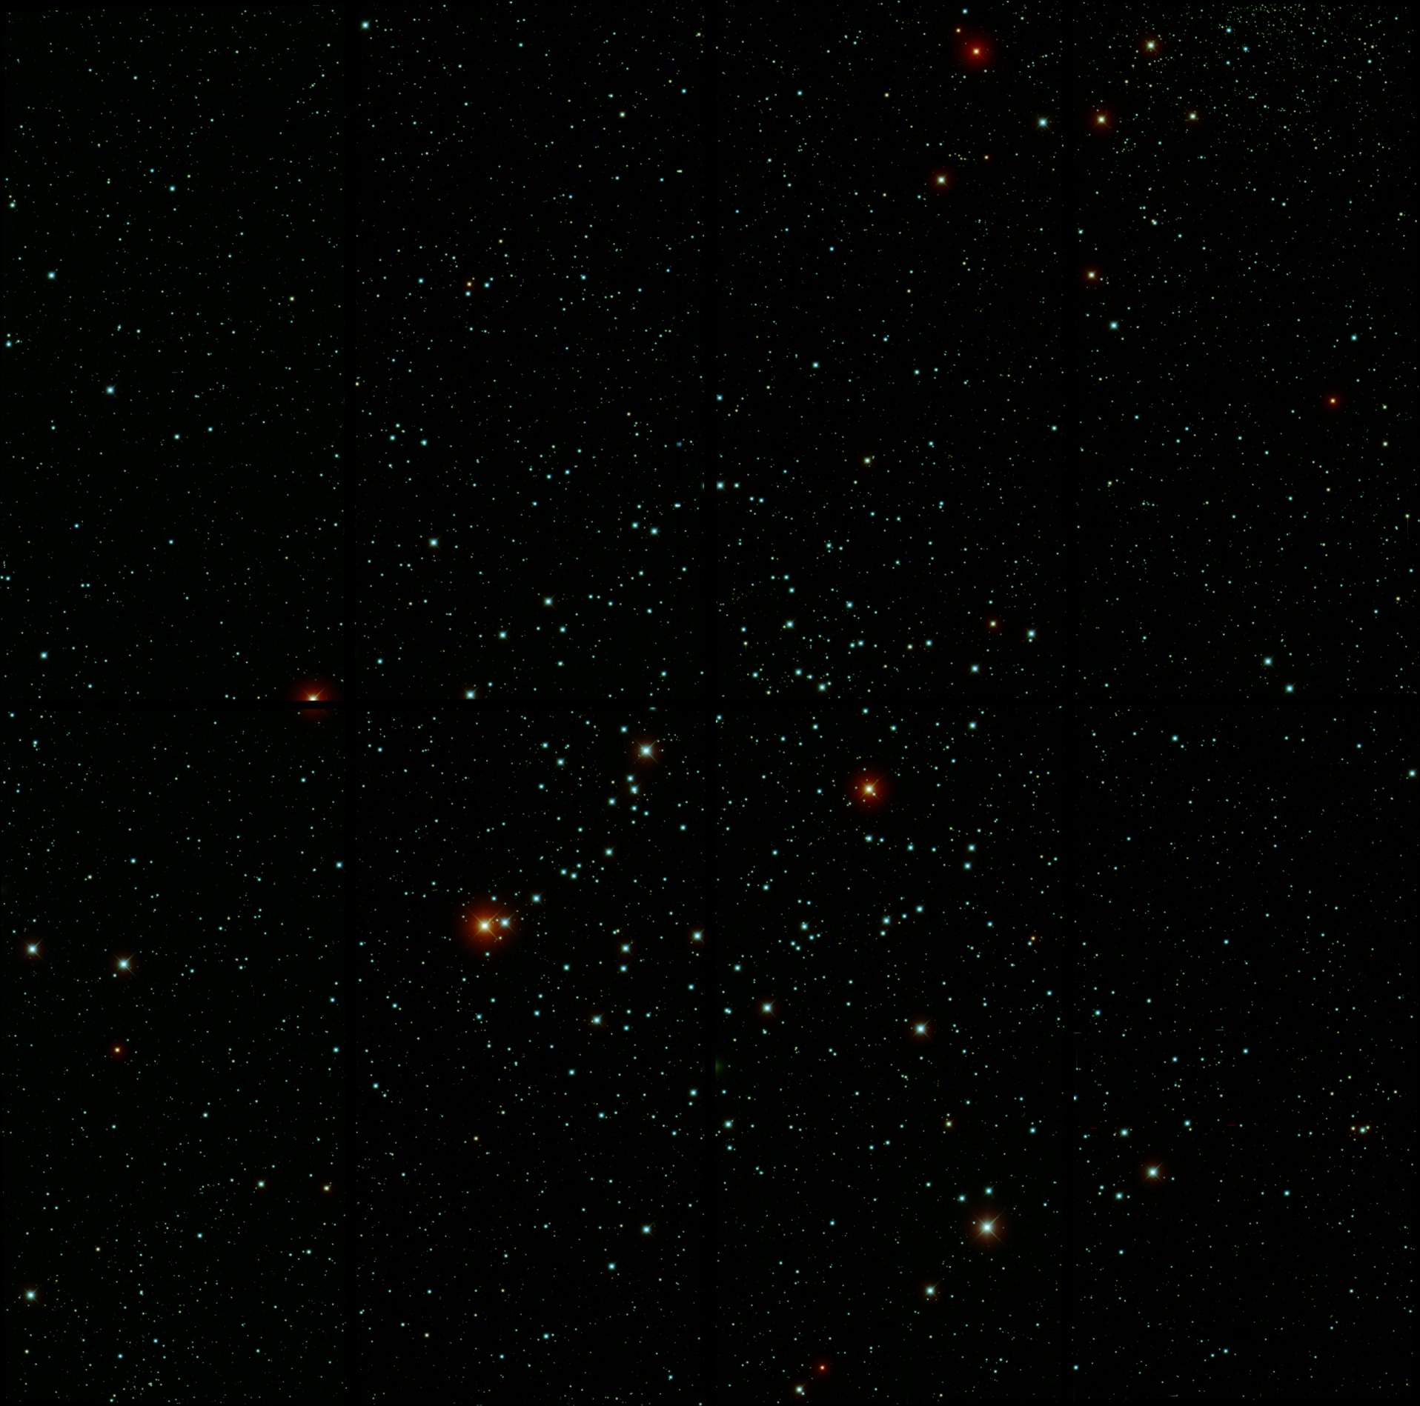
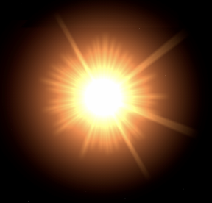
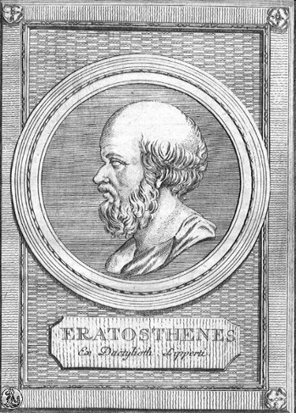
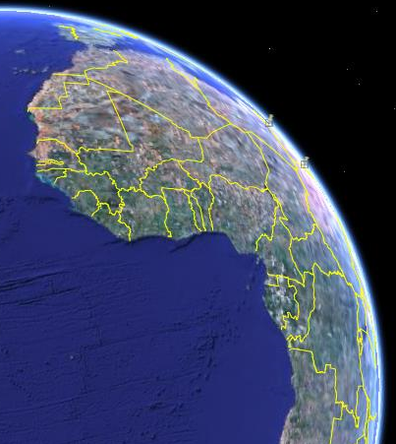
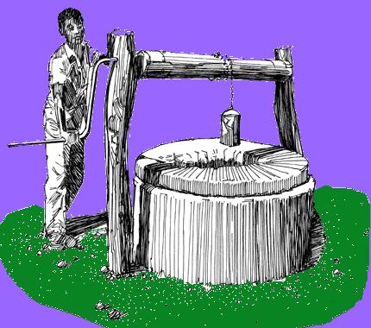
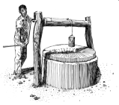
Sun not directly overhead
7 º 12’
or
1/50th
of a circle
Alexandria
500mi
Eratosthenes had observed that on the day of the summer solstice, the midday sun shone to the bottom of a well in the Ancient Egyptian city of Swenet (known in Greek as Syene).
Syene
He also knew that Alexandria and Syene were 500 miles apart
The accepted value along the equator is 24,902 miles, but, if you measure the earth through the poles the value is 24,860 miles
He was within 1% of today’s accepted value
Eratosthenes' conclusions were highly regarded at the time, and his estimate of the Earth’s size was accepted for hundreds of years afterwards.
To these observations, Eratosthenes concluded that the circumference of the earth was 50 x 500 miles, or 25000 miles.
He knew that at the same time, the sun was not directly overhead at Alexandria; instead, it cast a shadow with the vertical equal to 1/50th of a circle (7° 12').
Eratosthenes
Egypt about 240 BC
Notes:
He had observed that on the day of the summer solstice, the midday sun shone to the bottom of a well in the town of Syene (Aswan). Figure 1. At the same time, he observed the sun was not directly overhead at Alexandria; instead, it cast a shadow with the vertical equal to 1/50th of a circle (7° 12'). To these observations, Eratosthenes applied certain "known" facts (1) that on the day of the summer solstice, the midday sun was directly over the line of the summer Tropic Zone (Tropic of Cancer)-Syene was therefore concluded to be on this line; (2) the linear distance between Alexandria and Syene was 500 miles; (3) Alexandria and Syene lay on a direct northsouth line.
From these observations and "known" facts, Eratosthenes concluded that, since the angular deviation of the sun from the vertical at Alexandria was also the angle of the subtended arc, the linear distance between Alexandria and Syene was 1/50 of the circumference of the earth or 50 x 500 = 25,000 miles. A currently accepted value for the earth's circumference at the Equator is 24,901 miles, based upon the equatorial radius of the World Geodetic System (Chapter VIII). The actual unit of measure used by Eratosthenes was called the "stadia." No one knows for sure what the stadia that he used is in today's units. The measurements given above in miles were derived using one stadia equal to one-tenth statute mile.
It is remarkable that such accuracy was obtained in view of the fact that most of the "known" facts and his observations were incorrect: (1) although it is true that the sun at noon is directly overhead at the Tropic of Cancer on the day of the summer solstice, it was erroneously concluded that Syene lay on the line. Actually, Syene is 37 miles to the north; (2) the true distance between Alexandria and Syene is 453 miles and not 500; (3) Syene lies 3° 30' east of the meridian of Alexandria; (4) the difference of latitude between Alexandria and Syene is 7° 5' rather than 7° 12' as Eratosthenes had concluded.
Eratosthenes knew that on the summer solstice at local noon in the Ancient Egyptian city of Swenet (known in Greek as Syene) on the Tropic of Cancer, the sun would appear at the zenith, directly overhead. He also knew, from measurement, that in his hometown of Alexandria, the angle of elevation of the Sun would be 1/50 of a full circle (7°12') south of the zenith at the same time. Assuming that Alexandria was due north of Syene he concluded that the distance from Alexandria to Syene must be 1/50 of the total circumference of the Earth. His estimated distance between the cities was 5000 stadia (about 500 geographical miles or 950 km). He rounded the result to a final value of 700 stadia per degree, which implies a circumference of 252,000 stadia. The exact size of the stadion he used is frequently argued. The common Attic stadion was about 185 m, which would imply a circumference of 46,620 km, i.e. 16.3% too large. However, if we assume that Eratosthenes used the "Egyptian stadion"[1] of about 157.5 m, his measurement turns out to be 39,690 km, an error of less than 1%.[2]
Although Eratosthenes' method was well founded, the accuracy of his calculation was inherently limited. The accuracy of Eratosthenes' measurement would have been reduced by the fact that Syene is slightly north of the Tropic of Cancer, is not directly south of Alexandria, and the Sun appears as a disk located at a finite distance from the Earth instead of as a point source of light at an infinite distance. There are other sources of experimental error: the greatest limitation to Eratosthenes' method was that, in antiquity, overland distance measurements were not reliable, especially for travel along the non-linear Nile which was traveled primarily by boat. So the accuracy of Eratosthenes' size of the earth is surprising.
Eratosthenes' experiment was highly regarded at the time, and his estimate of the Earth’s size was accepted for hundreds of years afterwards. His method was used by Posidonius about 150 years later.

